Slide 1

PART 4 EVERYDAY JAVA
Modern Java In Action
Raoul-Gabriel Urma
Mario Fusco
Alan Mycroft

Slide 2
Fundamentals
Using Optional as a better alternative to null
New Date and Time API
Explores various features in Java 8 and Java 9 to make it easier and more reliable to code.
Default methods
The Java Module System

Slide 3
Using Optional as a better alternative to null
How to use model the absence of a value?
Introducing the Optional class
Patterns for adopting Optionals
Practical examples of using Optional

Slide 4
What’s wrong with null references
public class Person {
private Car car;
Public Car getCar() {
return car;
}
}
public class Car {
private Insurance insurance;
Public Insurance getInsurance() {
return insurance;
}
}
public class Insurance {
private String name;
Public String getName() {
return name;
}
}
public String getCarInsuranceName(person person) {
return person.getCar().getInsurance().getName();
}
getCar() is null
GetInsurance() is null
Person is null
=> NullPointerException

Slide 5
Reducing NullPointerException
Problem with null
Normal
Public String getCarInsuranceName(Person person) {
If (person != Null) {
Car car = person.getCar();
If (car != Null) {
Insurance insurance = car.getInsurance();
If (insurance != Null) {
return insurance.getName();
}
}
}
return "Unknown";
}
🡺 DEEPLY NESTED IF BLOCKS
It’s A Source Of Error
It Bloats Your Code.
It’s Meaningless
It Breaks Java Philosophy.
It Creates A Hole In The Type System

Slide 6



Optional Class
public class Person {
private Optional<Car> car;
public Optional<Car> getCar() {return car;}
}
public class Car {
private Optional<Insurance> insurance;
public Optional<Insurance> getInsurance() {return insurance;}
}
public class Insurance {
private String name;
public String getName() {return name;}
}
=> Optionals are Signals That A Missing Value Is Permitted There (missing value that expected) Easier to debug

Slide 7
Creating Optional Objects
Empty Optional
Optional From A Non-null Value
Optional From Null
Optional<Car> optcar = Optional.empty();
Car car = new Car();
Optional<Car> optcar = Optional.of(car);
=> If Car Were Null, A Nullpointerexception Would Be Thrown Immediately
Car car = new Car();
Optional<Car> optcar = Optional.ofNullable(car);
=> If Car Were Null, return Optional.empty()

Slide 8
MAP IN OPTIONAL
1
2
3
String name = null;
if(insurance != null){
name = insurance.getName();
}
String name = null;
Optional<Insurance> opt = Optional.ofNullable(insurance);
if(opt.isPresent()){
name = opt.get().getName();
}
Optional<Insurance> opt = Optional.ofNullable(insurance);
Optional<String> name = opt.map(Insurance::getName);
=>Use map to prevent if blocks

Slide 9
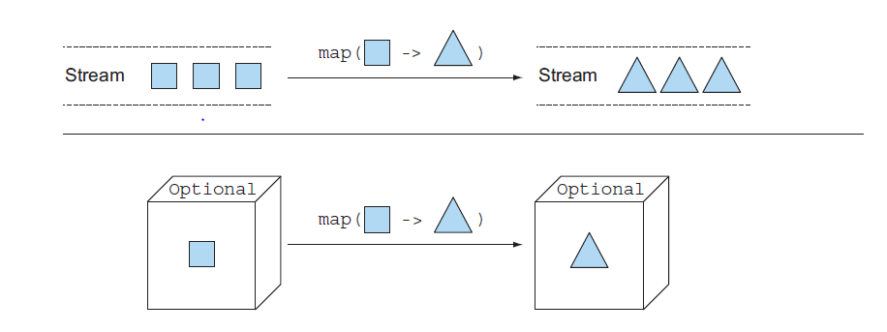
IS THERE ANY DIFFERENCES BETWEEN STREAM AND OPTIONAL

Slide 10

FLATMAP
public String getCarInsuranceName(Person person) {
return person.getCar().getInsurance().getName();
}
Optional<Person> optPerson = Optional.of(person);
Optional<String> name =
optPerson.map(Person::getCar)
.map(Car::getInsurance)
.map(Insurance::getName);
Unfortunately, this code doesn’t compile
Person::getCar returns Optional<Car>
public String getCarInsuranceName(Optional<Person> person) {
return person.flatMap(Person::getCar)
.flatMap(Car::getInsurance)
.map(Insurance::getName)
.orElse("Unknown");
}
flatMap

Slide 11
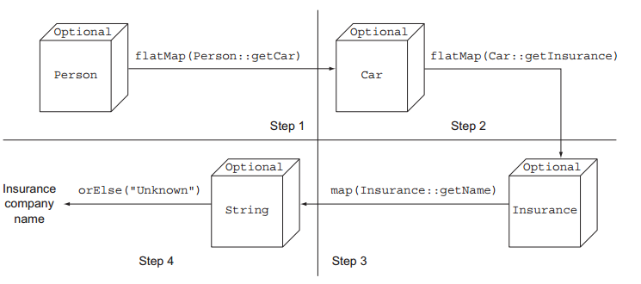
Explanation

Slide 12
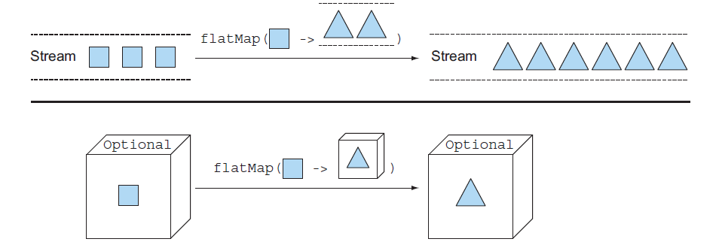
IS THERE ANY DIFFERENCES BETWEEN STREAM AND OPTIONAL

Slide 13
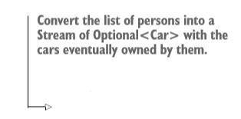
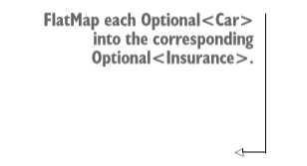
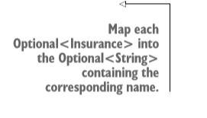
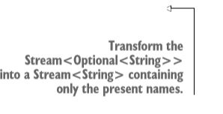
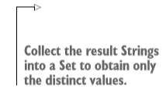
Using stream with optional
public Set<String> getCarInsuranceNames(List<Person> persons) {
return persons.stream()
.map(Person::getCar)
.map(optCar -> optCar.flatMap(Car::getInsurance))
.map(optInsurance -> optInsurance.map(Insurance::getName))
.flatMap(Optional::stream)
.collect(toSet());
}

Slide 14
Combination 2 Optionals
public Insurance findCheapestInsurance(Person person, Car car) {
// queries services provided by the different insurance companies
// compare all those data
return cheapestCompany;
}
public Optional<Insurance> nullSafeFindCheapestInsurance(Optional<Person> person, Optional<Car> car) {
if (person.isPresent() && car.isPresent()) {
return Optional.of(findCheapestInsurance(person.get(), car.get()));
} else {
return Optional.empty();
}
}
=> Too closely with the null checks
=> Not the good solution
Much better way =>>>
public Optional<Insurance> nullSafeFindCheapestInsuranceQuiz(Optional<Person> person, Optional<Car> car) {
return person.flatMap(p -> car.map(c -> findCheapestInsurance(p, c)));
}

Slide 15
Getting the value included the Optional
Java 8
get()
orElse(T other)
orElseGet(Supplier<? extends T> other)
or(Supplier<? extends Optional<? extends T>> supplier)
orElseThrow(Supplier<? extends X> exceptionSupplier)
ifPresent(Consumer<? extends T> consumer)
Additional methods in Java 9
ifPresentOrElse(Consumer<? super T> action, Runnable emptyAction)

Slide 16
Filter in Optional
Insurance insurance = ...;
if(insurance != null && "CambridgeInsurance".equals(insurance.getName())){
System.out.println("ok");
}
Optional<Insurance> optInsurance = ...;
optInsurance.filter(insurance ->
"CambridgeInsurance".equals(insurance.getName()))
.ifPresent(x -> System.out.println("ok"));

Slide 17
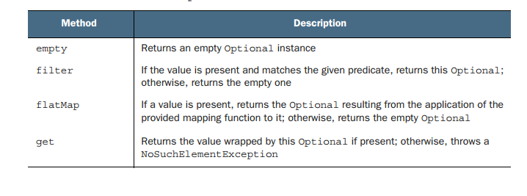
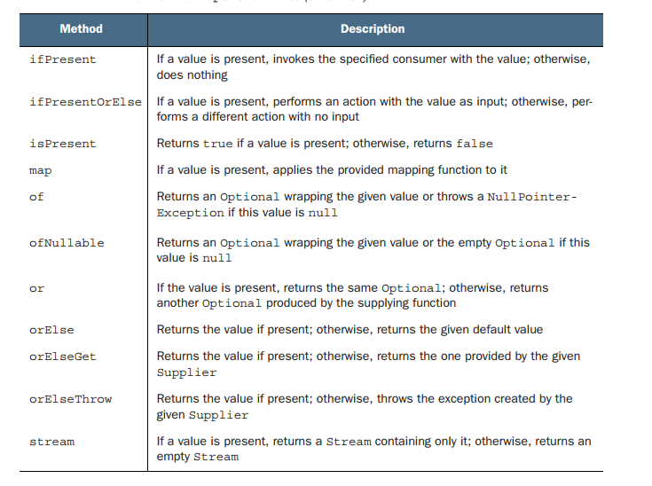

Slide 18
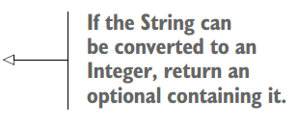

Practical examples of using Optional
Wrapping a potentially null value in an Optional Map<String, Object> map;
Exceptions vs Optional
As normal
Object value = map.get(“key”);
=> can return null
public static Optional<Integer> stringToInt(String s) {
try {
return Optional.of(Integer.parseInt(s));
} catch (NumberFormatException e) {
return Optional.empty();
}
}
Use Optional
Optional<Object> optValue = Optional.ofNullable(map.get(“key”));

Slide 19
Practical examples of using Optional
Primitive optionals (OptionalInt, OptionalLong, OptionalDouble,...)
public String getCarInsuranceName(Optional<Person> person) {
return person.flatMap(Person::getCar)
.flatMap(Car::getInsurance)
.map(Insurance::getName)
.orElse("Unknown");
}
=> shouldn’t use (not a common one)

Slide 20




Practical examples of using Optional
public int readDuration(Properties props, String name) {
String value = props.getProperty(name);
if (value != null) {
try {
int i = Integer.parseInt(value);
if (i > 0) {
return i;
}
} catch (NumberFormatException nfe) { }
}
return 0;
}
public int readDuration(Properties props, String name) {
return Optional.ofNullable(props.getProperty(name))
.flatMap(OptionalUtility::stringToInt)
.filter(i -> i > 0)
.orElse(0);
}

Slide 21
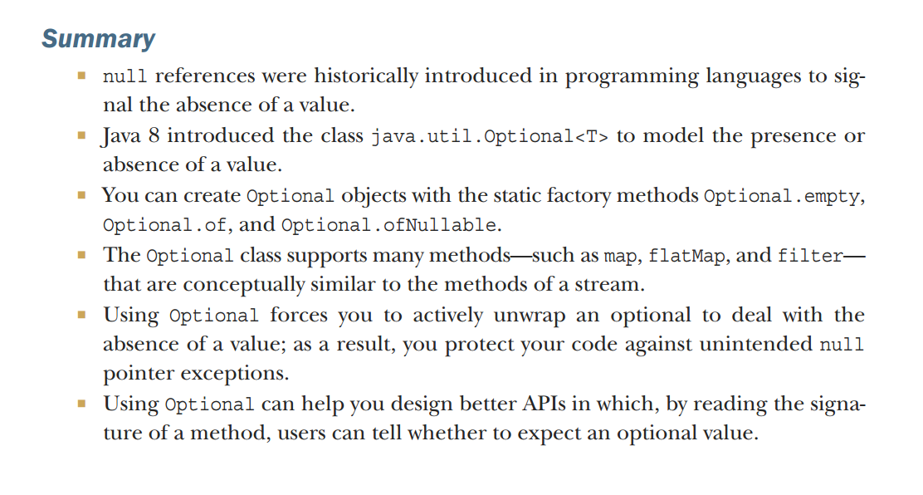
Summary

Slide 22

New Date and Time API
LocalDate, LocalTime, LocalDateTime, Instant, Duration, and Period
Manipulating, parsing and formatting dates
Working with different time zones and calendars
Summary

Slide 23







LocalDate, LocalTime, LocalDateTime, Instant, Duration, and Period (java.time)
Working with LocalDate and LocalTime
LocalDate
Immutable object representing a plain date without time of date
Doesn’t carry any information about Timezone
LocalDate today = LocalDate.now();
current date of system clock
LocalDate date = LocalDate.of(2017, 9, 21);
int year = date.getYear();
Month month = date.getMonth();
int day = date.getDayOfMonth();
DayOfWeek dow = date.getDayOfWeek();
int len = date.lengthOfMonth();
boolean leap = date.isLeapYear();

Slide 24



LocalDate, LocalTime, LocalDateTime, Instant, Duration, and Period (java.time)
Working with LocalDate and LocalTime
LocalTime
Immutable object representing a plain date without time of date
Doesn’t carry any information about Timezone
LocalTime time = LocalTime.of(13, 45, 20);
int hour = time.getHour();
int minute = time.getMinute();
int second = time.getSecond();
Throw a DateTimeParseExeption extends RunTime-Exeption

Slide 25


LocalDateTime
// 2017-09-21T13:45:20
LocalDateTime dt1 = LocalDateTime.of(2017, Month.SEPTEMBER, 21, 13, 45, 20);
LocalDateTime dt2 = LocalDateTime.of(date, time);
LocalDateTime dt3 = date.atTime(13, 45, 20);
LocalDateTime dt4 = date.atTime(time);
LocalDateTime dt5 = time.atDate(date);
LocalDate date1 = dt1.toLocalDate();
LocalTime time1 = dt1.toLocalTime();

Slide 26
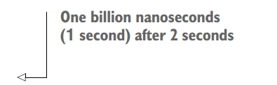
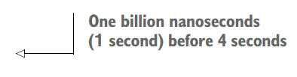
Instant
To be used by machine
Instant.ofEpochSecond(3);
Instant.ofEpochSecond(3, 0);
Instant.ofEpochSecond(2, 1_000_000_000);
Instant.ofEpochSecond(4, -1_000_000_000);

Slide 27
Duration or Period
Duration d1 = Duration.between(time1, time2);
Duration d1 = Duration.between(dateTime1, dateTime2);
Duration d2 = Duration.between(instant1, instant2);
Period tenDays = Period.between(LocalDate.of(2017, 9, 11),
LocalDate.of(2017, 9, 21));
Duration threeMinutes = Duration.ofMinutes(3);
Duration threeMinutes = Duration.of(3, ChronoUnit.MINUTES);
Period tenDays = Period.ofDays(10);
Period threeWeeks = Period.ofWeeks(3);
Period twoYearsSixMonthsOneDay = Period.of(2, 6, 1);

Slide 28
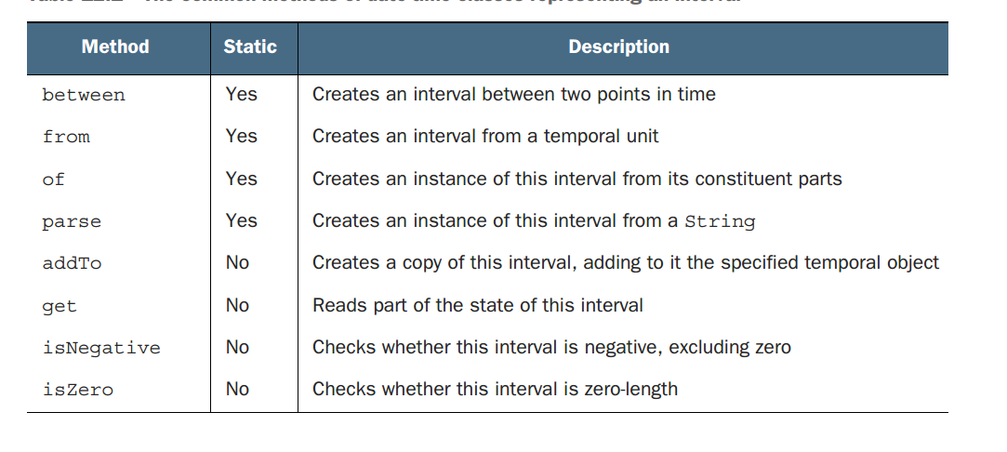
Common methods in Duration and Period

Slide 29
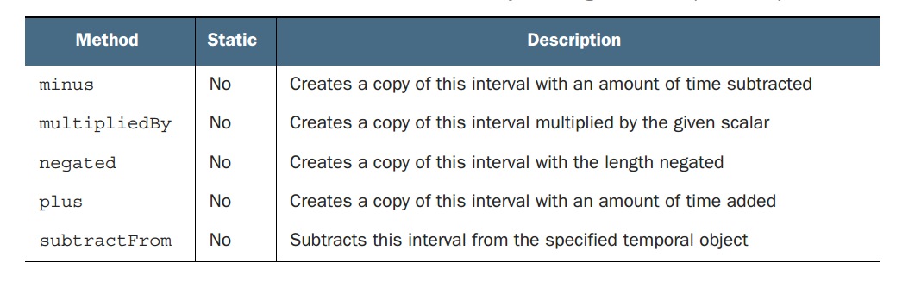
Common methods in Duration and Period

Slide 30



Manipulating, parsing, formatting dates
LocalDate date1 = LocalDate.of(2017, 9, 21);
LocalDate date2 = date1.withYear(2011);
LocalDate date3 = date2.withDayOfMonth(25);
LocalDate date4 = date3.with(ChronoField.MONTH_OF_YEAR, 2);
LocalDate date1 = LocalDate.of(2017, 9, 21);
LocalDate date2 = date1.plusWeeks(1);
LocalDate date3 = date2.minusYears(6);
LocalDate date4 = date3.plus(6, ChronoUnit.MONTHS);
All the classes are immutable, so we can not modify the existing object!

Slide 31
Example
LocalDate date = LocalDate.of(2014, 3, 18);
date = date.with(ChronoField.MONTH_OF_YEAR, 9);
date = date.plusYears(2).minusDays(10);
date.withYear(2011);
Answer:
2016-09-08

Slide 32
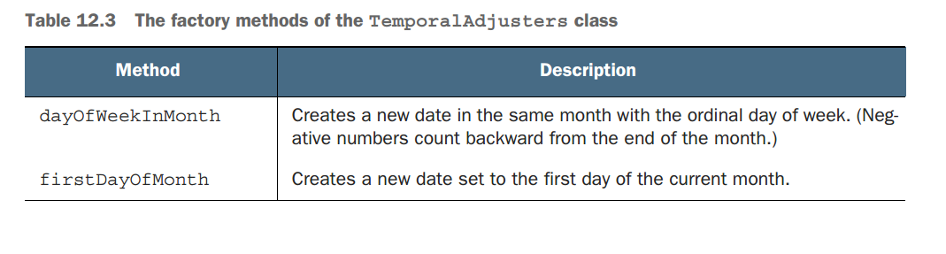
TemporalAdjusters class

Slide 33
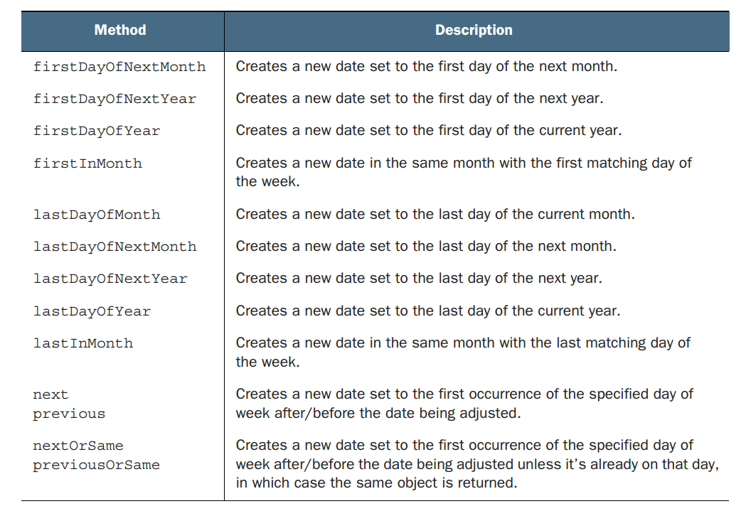

Slide 34
TemporalAdjusters class
@FunctionalInterface
public interface TemporalAdjuster {
Temporal adjustInto(Temporal temporal);
}

Slide 35
Printing and parsing date-time objects
Using DateTimeFormatter
LocalDate date = LocalDate.of(2014, 3, 18);
String s1 = date.format(DateTimeFormatter.BASIC_ISO_DATE);
String s2 = date.format(DateTimeFormatter.ISO_LOCAL_DATE);
LocalDate date1 = LocalDate.parse("20140318",DateTimeFormatter.BASIC_ISO_DATE);
LocalDate date2 = LocalDate.parse("2014-03-18",DateTimeFormatter.ISO_LOCAL_DATE);

Slide 36
DateTimeFormatter
Also supports a static factory method to create formatter from specific pattern
Also supports creating a formatter for given Locale
DateTimeFormatter formatter = DateTimeFormatter.ofPattern("dd/MM/yyyy");
LocalDate date1 = LocalDate.of(2014, 3, 18);
String formattedDate = date1.format(formatter);
LocalDate date2 = LocalDate.parse(formattedDate, formatter); // 03/18/2014
DateTimeFormatter italianFormatter =
DateTimeFormatter.ofPattern("d. MMMM yyyy", Locale.ITALIAN);
LocalDate date1 = LocalDate.of(2014, 3, 18);
String formattedDate = date.format(italianFormatter); // 18. marzo 2014
LocalDate date2 = LocalDate.parse(formattedDate, italianFormatter);

Slide 37
DateTimeFormatter
Supports creating a complex format with DateTimeFormatterBuilder
DateTimeFormatter italianFormatter = new DateTimeFormatterBuilder()
.appendText(ChronoField.DAY_OF_MONTH)
.appendLiteral(". ")
.appendText(ChronoField.MONTH_OF_YEAR)
.appendLiteral(" ")
.appendText(ChronoField.YEAR)
.parseCaseInsensitive()
.toFormatter(Locale.ITALIAN); // 18. marzo 2014

Slide 38
Working with different time zones and calendars
Using java.time.ZoneId instead of java.util.TimeZone
=> Immutable

Slide 39
Using time zones
ZoneId romeZone = ZoneId.of("Europe/Rome");
The region IDs are in the format “{area}/{city}”
// Convert TimeZone into ZoneId
ZoneId zoneId = TimeZone.getDefault().toZoneId();

Slide 40
Using time zones
Combine with LocalDate, LocalDateTime, Instant
LocalDate date = LocalDate.of(2014, Month.MARCH, 18);
ZonedDateTime zdt1 = date.atStartOfDay(romeZone);
LocalDateTime dateTime = LocalDateTime.of(2014, Month.MARCH, 18, 13, 45);
ZonedDateTime zdt2 = dateTime.atZone(romeZone);
Instant instant = Instant.now();
ZonedDateTime zdt3 = instant.atZone(romeZone);

Slide 41
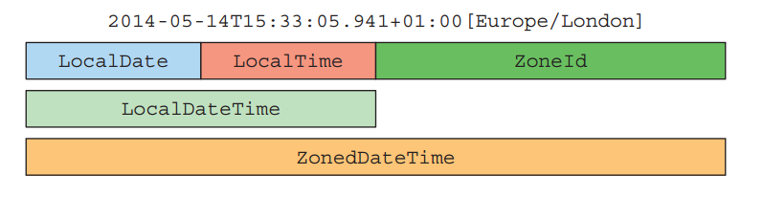
Using time zones

Slide 42
Using time zones
Covert LocalDateTime and Instant to each others
LocalDateTime dateTime = LocalDateTime.of(2014, Month.MARCH, 18, 13, 45);
Instant instantFromDateTime = dateTime.toInstant(romeZone);
Instant instant = Instant.now();
LocalDateTime timeFromInstant = LocalDateTime.ofInstant(instant, romeZone);

Slide 43
Fixed offet from UTC/Greenwich
ZoneOffset newYorkOffset = ZoneOffset.of("-05:00");
LocalDateTime dateTime = LocalDateTime.of(2014, Month.MARCH, 18, 13, 45);
OffsetDateTime dateTimeInNewYork = OffsetDateTime.of(date, newYorkOffset);

Slide 44
Using alternative calendar systems
LocalDate date = LocalDate.of(2014, Month.MARCH, 18);
JapaneseDate japaneseDate = JapaneseDate.from(date);
Chronology japaneseChronology = Chronology.ofLocale(Locale.JAPAN);
ChronoLocalDate now = japaneseChronology.dateNow();

Slide 45
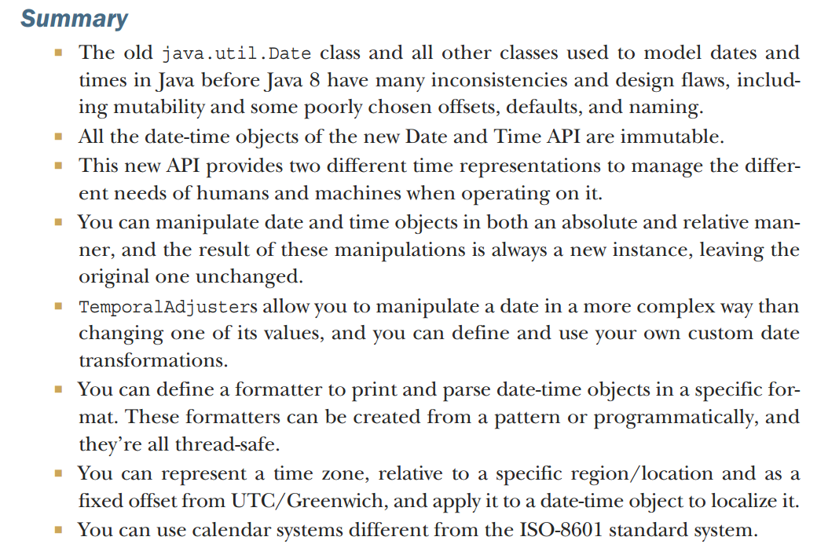

Slide 46
Default methods
Evolving APIs
Default methods in a nutshell
Usage patterns for default methods
Resolution rules
Summary

Slide 47

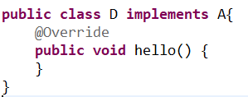
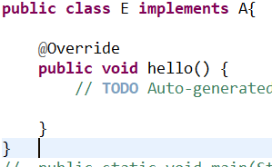
Evolving APIs
What will happen if A has more methods?

Slide 48
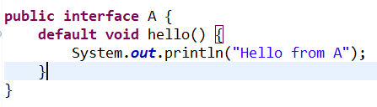

Default methods in nutshell
Default methods start with default keyword and contain a body
The subclass doesn’t need to implement default methods, it automatically inherits the default methods from interface.

Slide 49
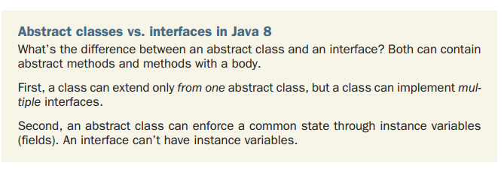
Usage patterns for default methods
Default methods can be used for optional methods.

Slide 50
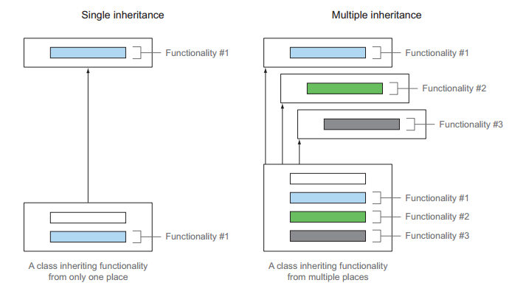
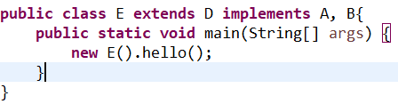
Usage patterns for default methods
Multiple inheritance of behavior

Slide 51
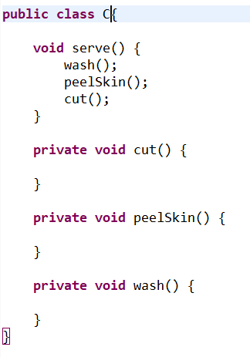
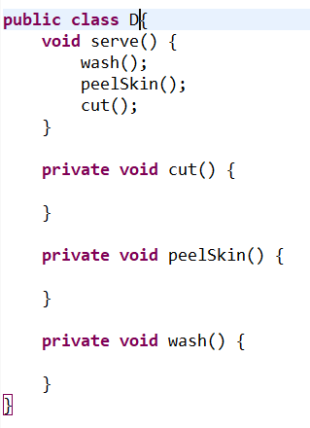
Usage patterns for default methods
Multiple inheritance of behavior

Slide 52
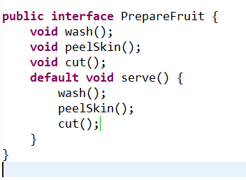
Usage patterns for default methods
Minimal interfaces with orthogonal functionalities
Subclasses have to implement methods inside default method
A skeleton algorithm
Related to template pattern

Slide 53
Usage patterns for default methods
Resolution rules
Classes always win. The methods declared in class always have priority over the default methods
Otherwise, subinterfaces always win. The method with the same signature in the most specific default-providing interface is selected. (B extends from A-> B is more specific than B)
if the choice is still ambiguous, we have to select which default method implementation to use.

Slide 54
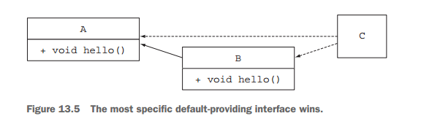
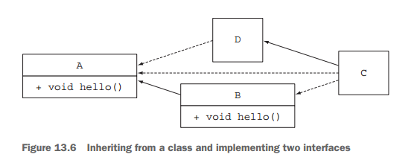
Example
The hello method from B is selected
The hello method from B is selected

Slide 55

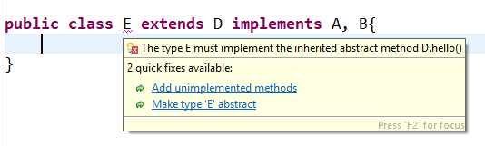
Example

Slide 56
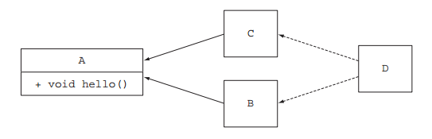
The diamond problem
What happens if B and C also have hello() method? Which default method will be chosen for D?

Slide 57
The Java Module System
The driving force:reasoning about software
Default methods in a nutshell
Usage patterns for default methods
Resolution rules
Summary

Slide 58
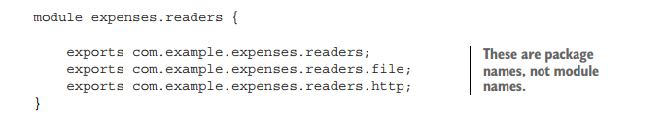
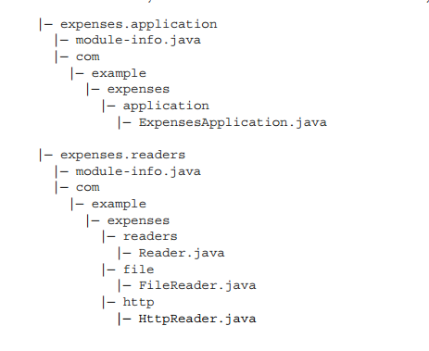
Working with several module

Slide 59
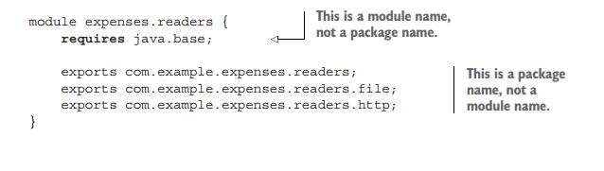
Working with several module
Use requires {module name} to import other modules

Slide 60
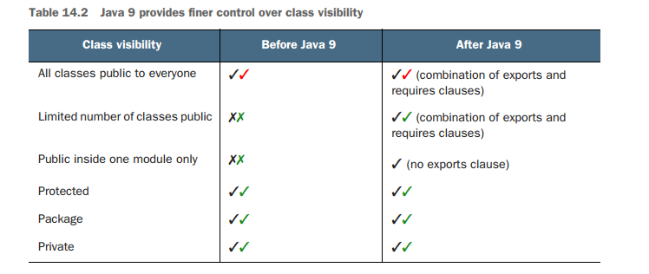
Working with several module

Slide 61
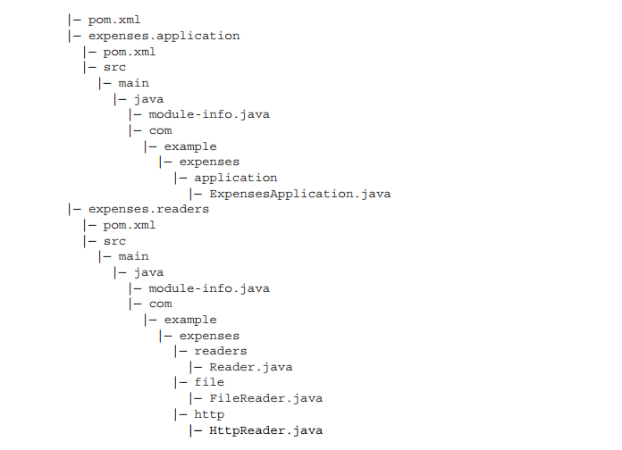
Compiling and packaging

Slide 62
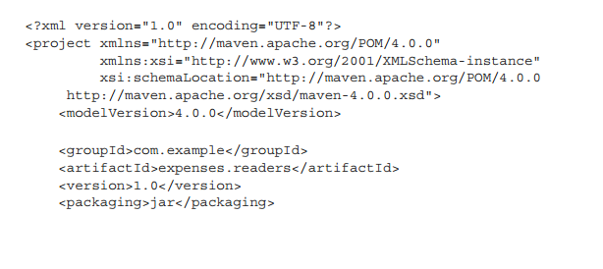
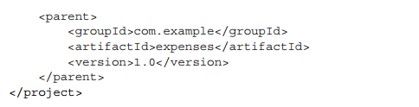
Compiling and packaging
expenses.readers module pom.xml file

Slide 63
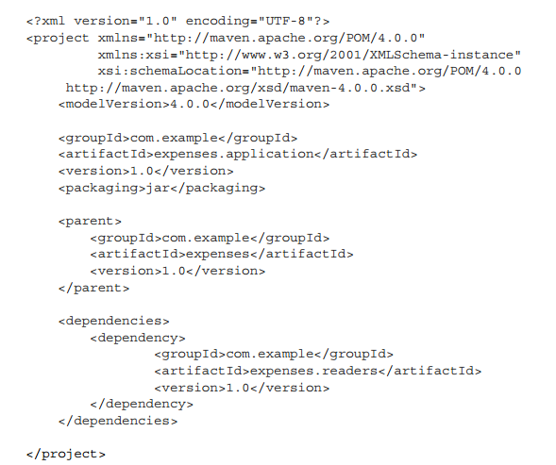
Compiling and packaging
expenses.application module pom.xml file

Slide 64
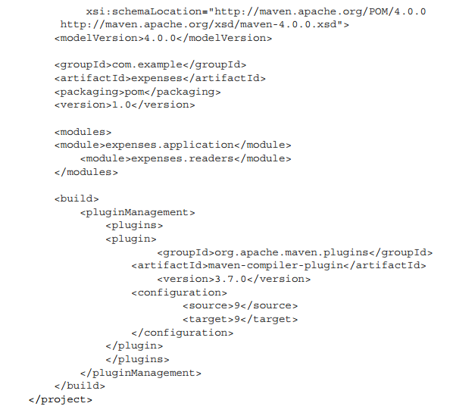
Compiling and packaging
expenses module pom.xml file

Slide 65

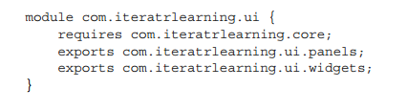
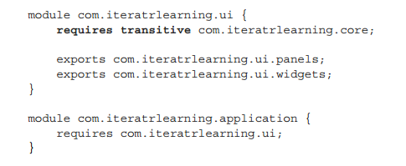
Module declaration and clauses
requires
exports
requires transitive

Slide 66
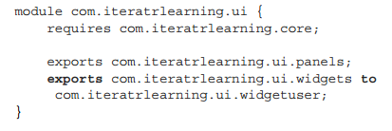

Module declaration and clauses
exports to
open and opens
uses and provides

Slide 67
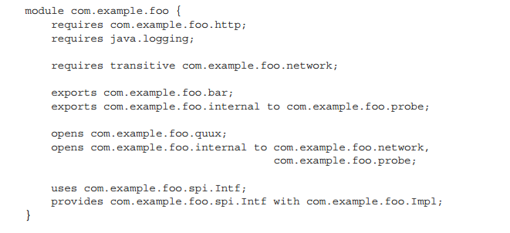
A bigger example

Slide 68
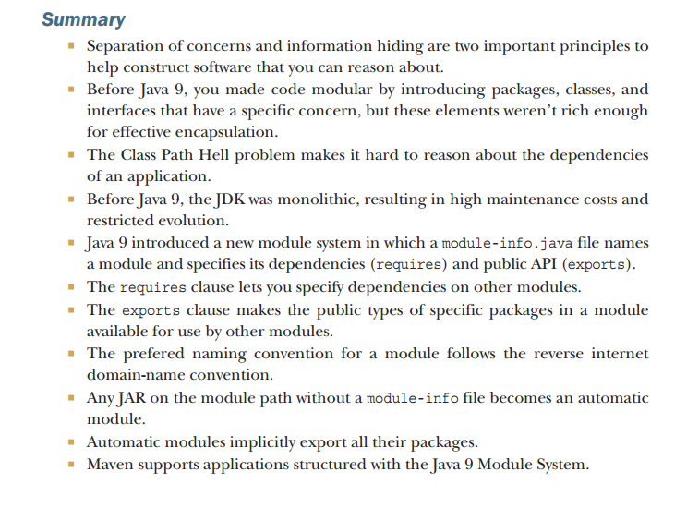

Slide 69
THANK YOU!

